Slide 1
Programing the car II

Slide 2
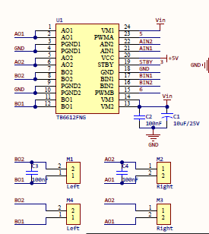
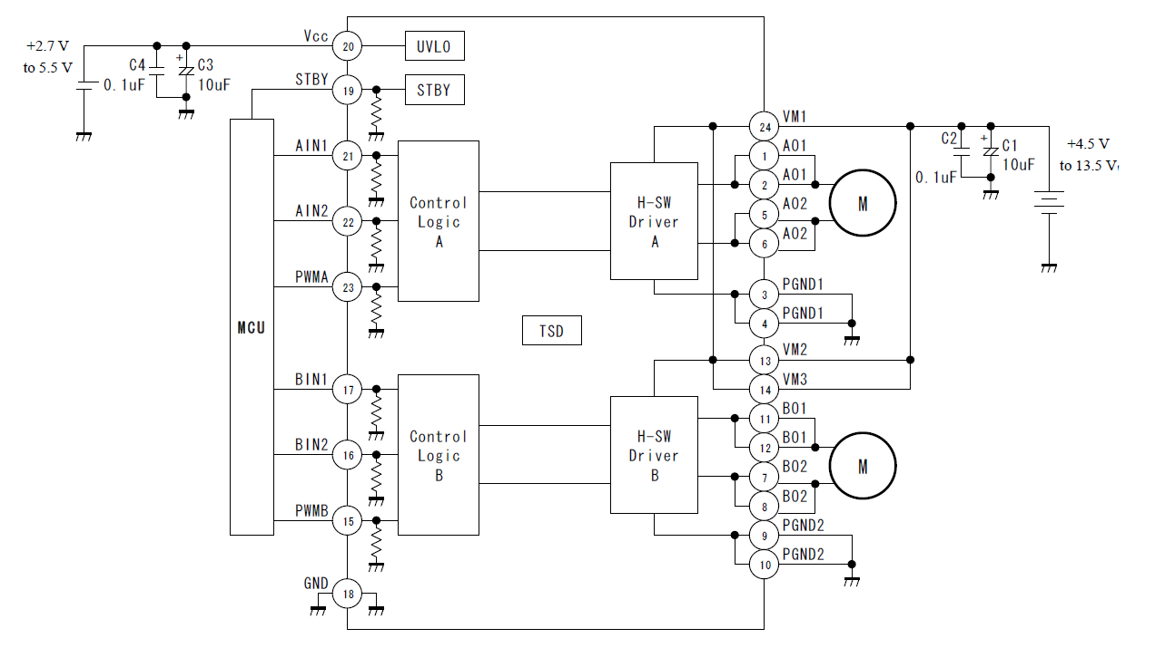
Let’s move the car
Car has 4 individually controlled motors attached to 4 wheels
Each motor draw large current during operation and may sometime can produce inductance current that can damage the electronics.
for this reason, car use a dedicated motor drive IC TB6612
Motor drive can drive 2 motors
2 left side motor operate as a one motor and 2 right side motor operate as a one motor

Slide 3
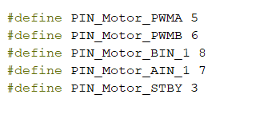
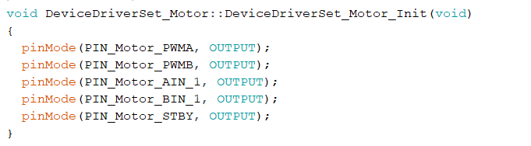
Move the car
Due to the configuration, this car behave differently than a read car. In order to turn the car, we need rely on the relative wheel motion.
Let’s see what mode of operations we can get.
Please open the SCamp-D2-S2-E1.ino example
DeviceDriverSet_xxx0.h and DeviceDriverSet_xxx0.cpp defines low level functions that govern the control of motor control IC.
In the DeviceDriverSet_xxx0.h we set GPIO pins and in the DeviceDriverSet_xxx0.cpp we set these pins to output mode

Slide 4
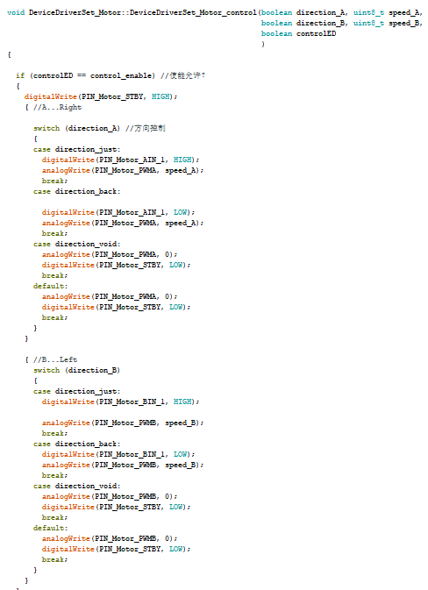
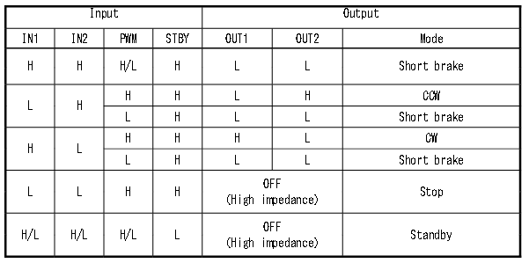
Move the car
Now following chart illustrate the chip behavior
Code segment implementation

Slide 5
Move the car
Base of these basic operation modes we can generate 9 higher level operations
Please open ApplicationFuctionSet_xxx.cpp file and examine
Upload the code to the car. Please be careful car will start to move as soon as code is uploaded to the car. Keep the car in a safe location.
Once the code is upload to the car, remove the cable, move the connector switch to the cam position and place the car on the ground, power it on.
Once power on, car will start to move.

Slide 6
Can we drive straight
Let’s try to drive the car repeatedly forward and backward
Please open the SCamp-D2-S2-E2.ino example
This code move the car indefinitely forward and backward.
Upload it to the car and observe the behavior
You will notice that the car deviate from a straight line with time. This is because not all wheel experience same friction, different terrain has different properties, they are not uniform, also individual motor may have slight differences from each other.
In order to drive the car straight we will need to actively make corrections to the slight deviation car is experiencing on the fly.
We can achieve by introducing close loop control system. Close loop control system is defined as a mechanism that automatically regulates a system to maintain a desired state or set point without human interaction

Slide 7
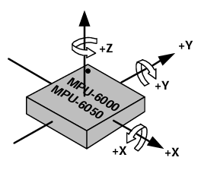
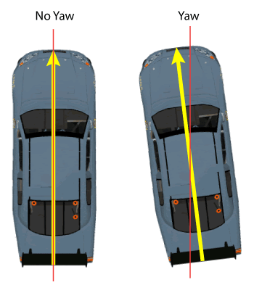
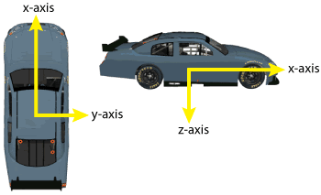
Detecting what is wrong
Before we do any correction, we need to know whether car is moving on a straight line or not.
Luckily, our car is quipped with a 3-axis gyroscope and 3-axis accelerometer
Gyroscope can be used to detect the deviation of the car with respect to initial position. Gyroscope measures rotational velocity or rate of change of the angular position over time, along the X, Y and Z axis.
The outputs of the gyroscope are in degrees per second, so in order to get the angular position we just need to integrate the angular velocity.
If car deviate from it yaw position, then we should be able to detect it using the gyroscope. Yaw is rotation around z axis

Slide 8
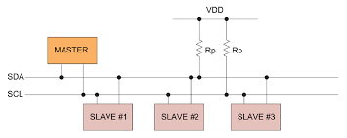
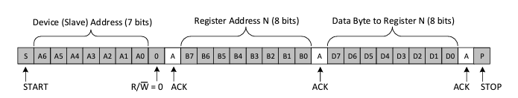

Detecting Yaw
Let’s read data from the MPU6050 chip.
Please open SCamp-D2-S2-E3.ino example
MPU6050 is connected to our microcontroller using I2C bus
I2C is two wire serial communication protocol, that is very easy to implement
One of the wire (SCL) acts as clock and other wire (SDA) acts as data, each device is identified with a device ID. Master node must specify which device ID it is trying to access at the beginning of the massage

Slide 9
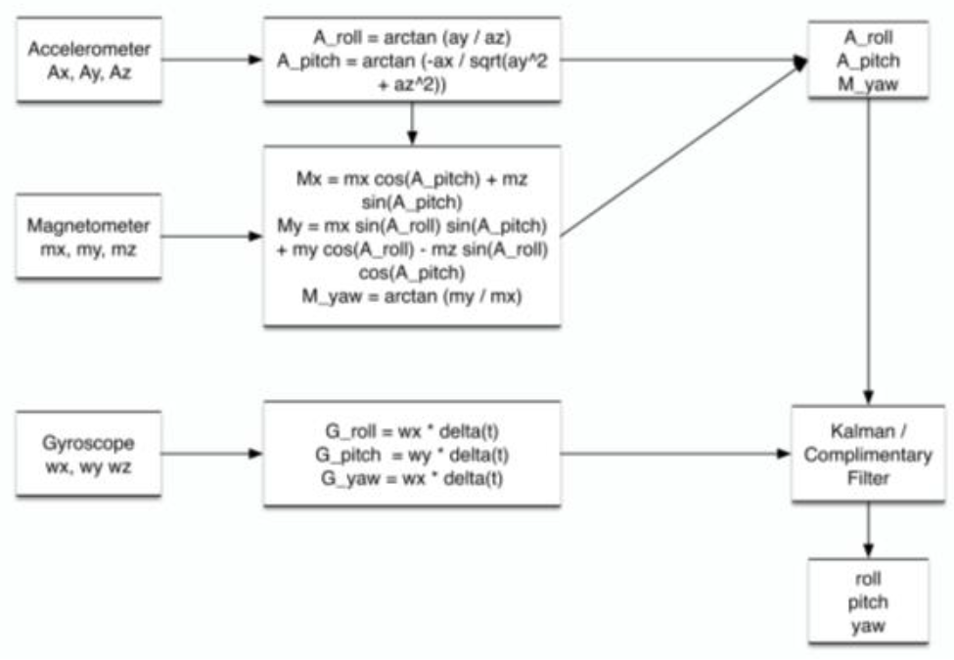
Detecting Yaw
MPU6050_getdata.cpp code defines functions to communicate with MPU6050 chip and get the data from it. However, before we do anything we need to initiate the chip and calibrate it. MPU6050_dveInit() function initiate the chip and MPU6050_calibration() function calibrate. Notice that we are using average values as the gyroscope in general are susceptible to data drift.
MPU6050_dveGetEulerAngles() function returns the Yaw angle. Please note his is only accurate in short term.
We could combine magnetometer with accelerometer and gyroscope to achieve mor accurate value

Slide 10
Detecting Yaw
Compile SCamp-D2-S2-E3.ino example and upload it to the car. Open the serial monitor. If you have not changed the car position since upload you should see it report zero and fluctuate slightly around that value.
If car has moved then you will see it fluctuate around some value, notice it can be positive or negative.
Rotate the car around z axis and observe the data change.

Slide 11
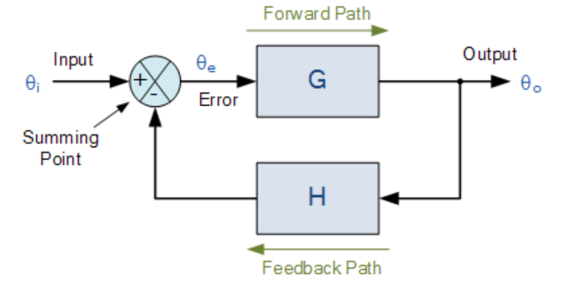
Close control loop
There are many types of control systems. In the simplest term we can implement a change proportional to the difference between desired state and actual state, which is error.
Open SCamp-D2-S2-E4 and examine the code
Compile and upload the code and see how it behave

Slide 12
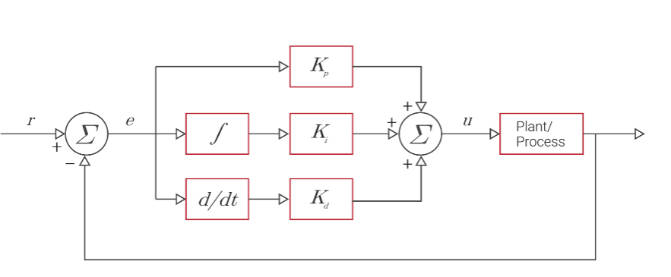

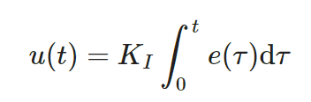
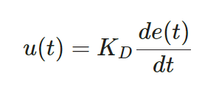
Exercise
Accuracy of the control system can be improved by incorporating integral term and differential term
The integral term (I) integrates the error between the desired state and the measured state over time and scales this by a gain value, KI
When used in conjunction with proportional control, this integration acts as a low-pass filter and eliminates the steady-state errors in the system.
The derivative term (D) acts on the current rate of change of the error and is scaled by a gain value, Kd
This allows the controller to anticipate the future trend of the error. The more rapid the rate of change of the error, the more impact the derivative controller has on the system. When properly tuned, the derivative term prevents the system from overshooting the desired state.
See you can implement PID controller

